Slide 1
Automated Health Clinic Management
Jalal Mammadov
Mario Uesaka

Slide 2
Project overview

Slide 3
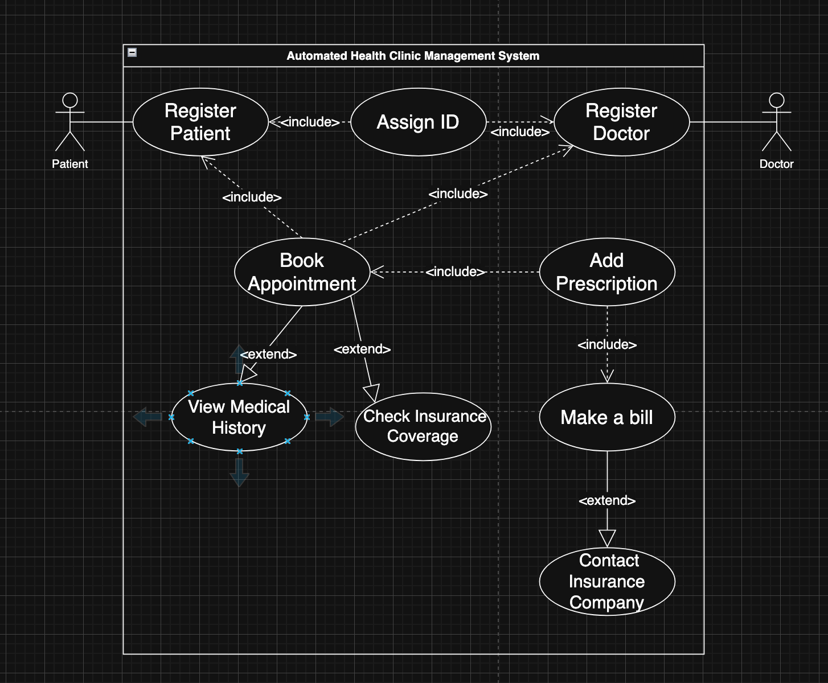
Use case Diagram

Slide 4
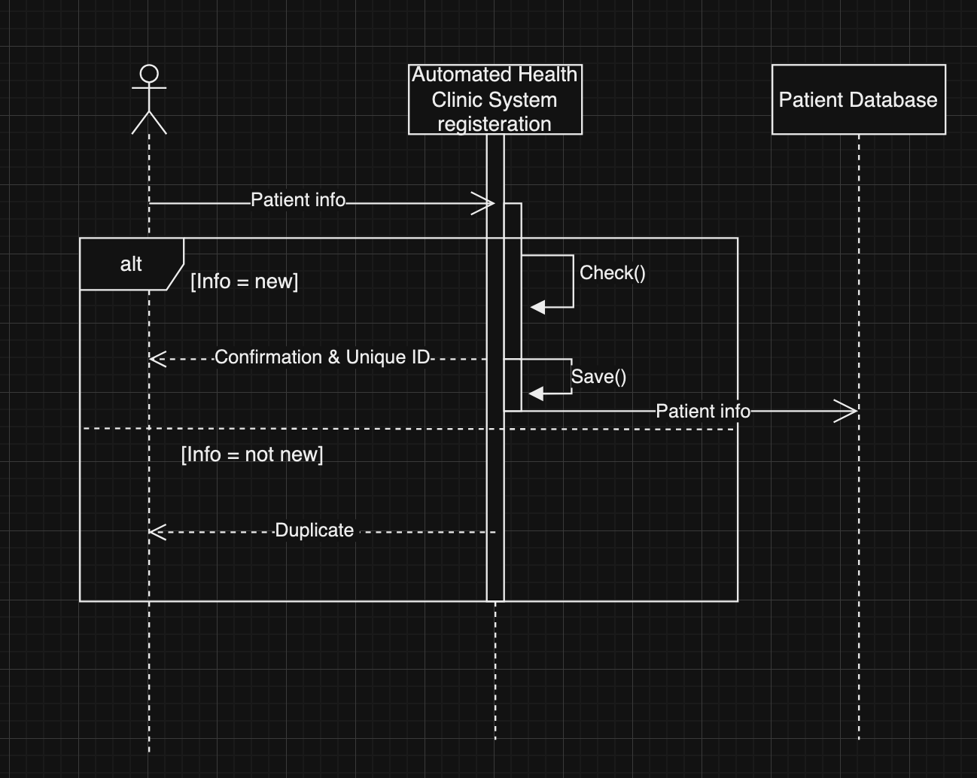
Sequence diagram / registration

Slide 5
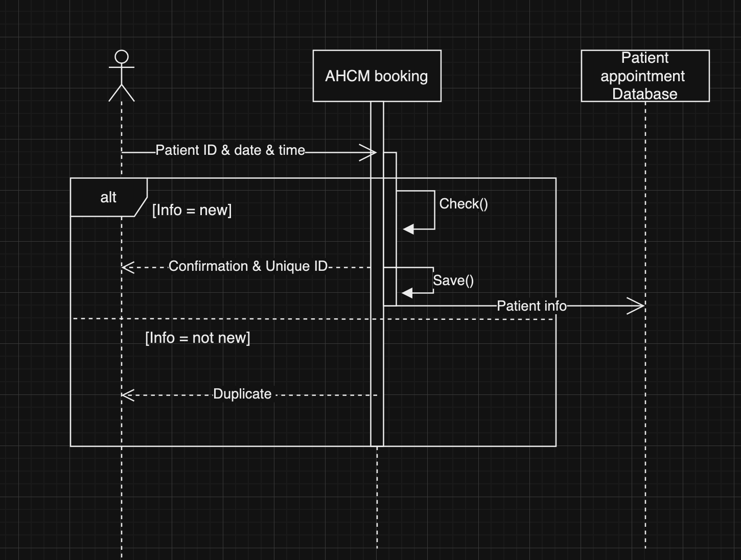
Sequence diagram/ booking

Slide 6
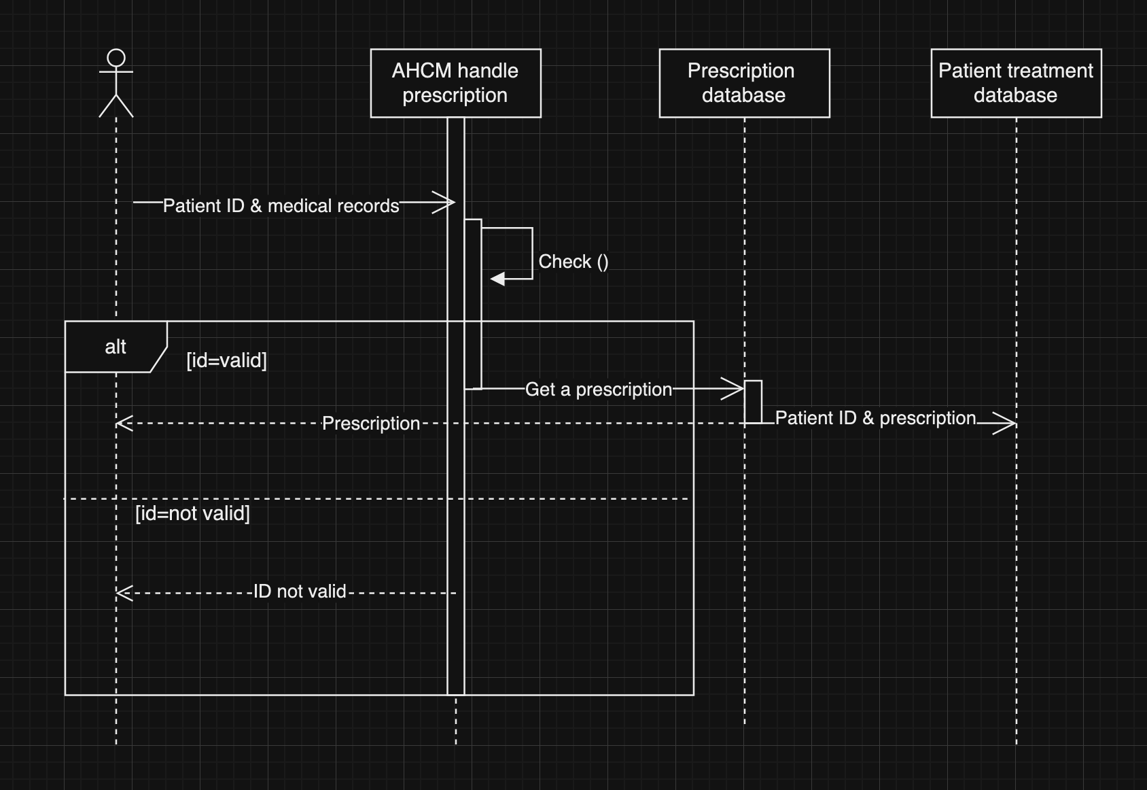
Sequence diagram / Prescription

Slide 7
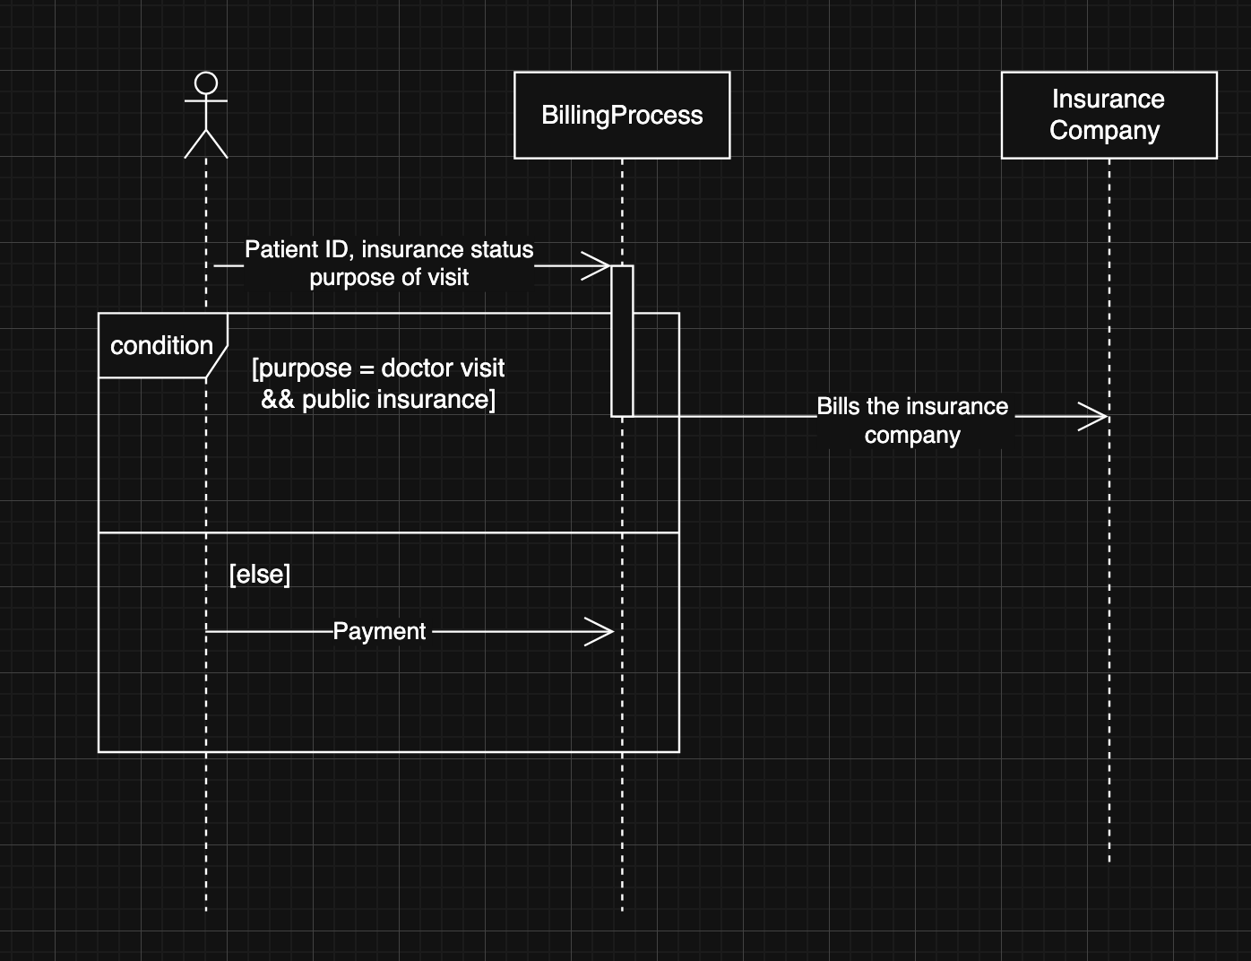
Sequence Diagram / Billing

Slide 8
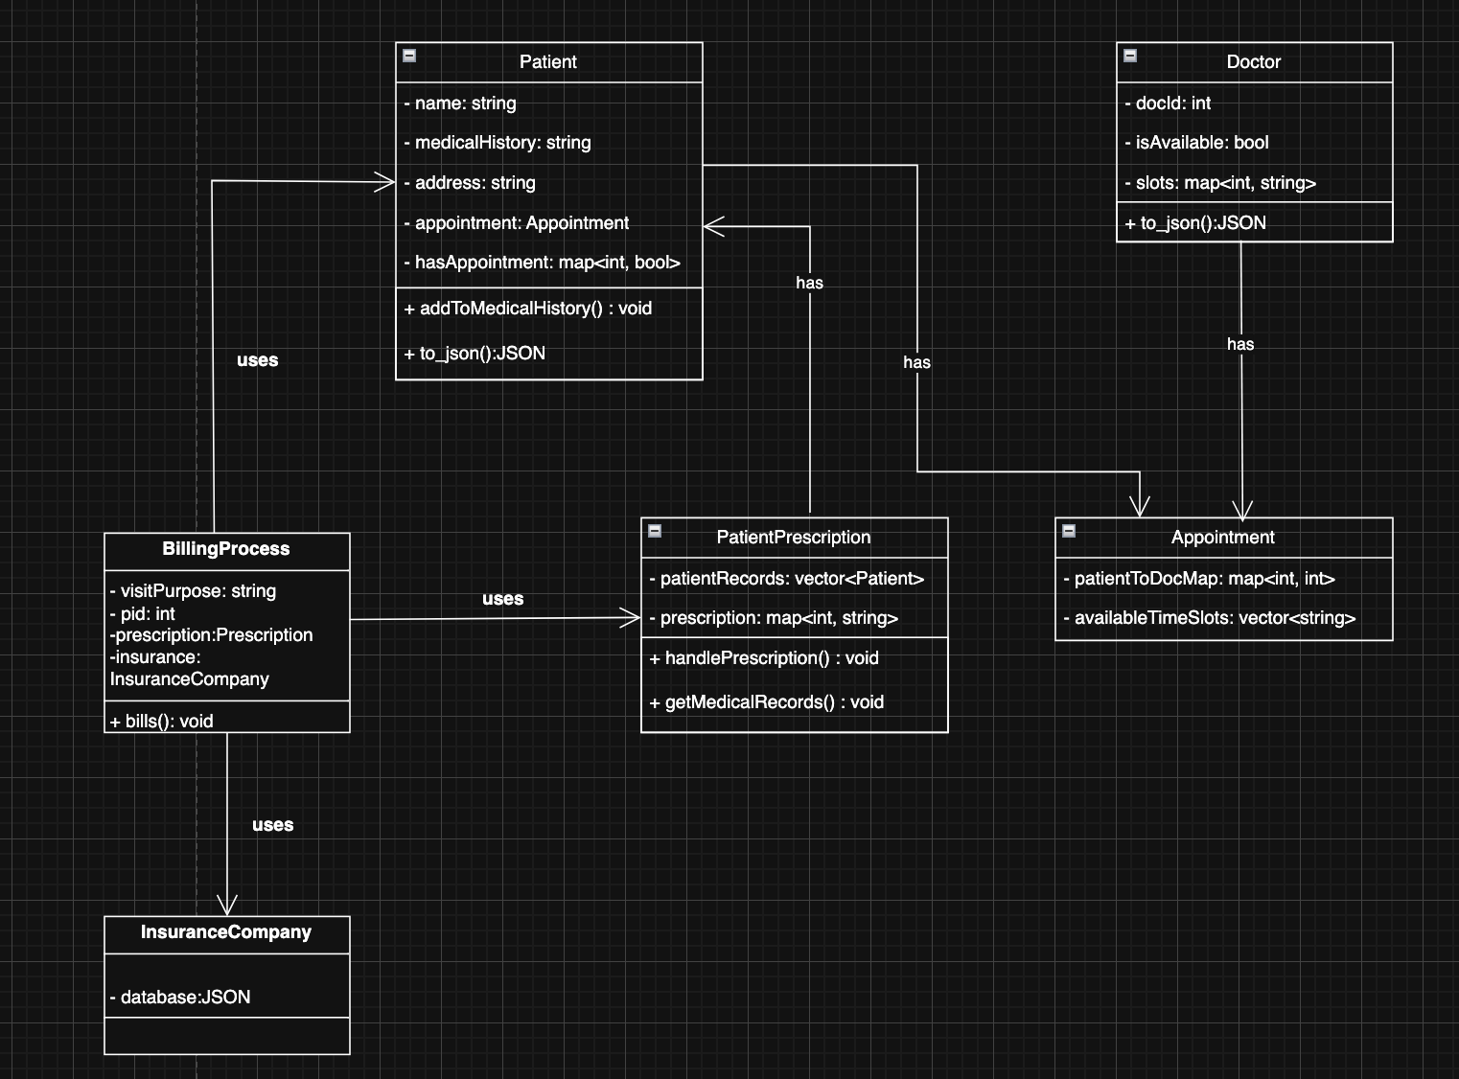
Class diagram

Slide 9
System implementation

